Slide 1
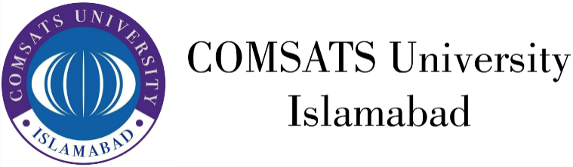
HUM111 Pakistan Studies
Lecture 28

Slide 2
HUM 111 Pakistan Studies
Geo-strategic Importance of Pakistan (B)
Dr. Sohail Ahmad

Slide 3
Strategic Significance
Proximity of great powers:
Pakistan is located at the junction of great powers- Russia and China.
Any alliance among world powers enhances its significance.
This factor has been utilized by Pakistan after 9/11.
Security and business are two main US interests in the region while Pakistan is playing a front line role in the war against terrorism.
Apart from this US interest in the region to contain the growing China, nuclear Iran, terrorist Afghanistan and to benefit from the market of India.

Slide 4
Strategic Significance
Proximity of great powers (Contd..)
Iran’s nuclear program, India’s geopolitical muscles (strategic deal with US) to gain hegemony and to counter the rise of China, which has the potential to change uni-poler world into a bi-polar or multi-polar one.
Amidst these issues, Pakistan is directly or indirectly involved. The US policy makers have repeatedly accepted that war against terrorism could never be won without the help of Pakistan.
The US has time and time again reiterated that Pakistan should play its due role to bring the Afghan Taliban to the negotiation table with the Afghan government.

Slide 5
Strategic Significance
Gateway to central Asia-(oil and energy):
The quest for oil and energy resources in the Central Asia is the center stage of new Great Game.
After the collapse of the USSR, the new quest started which is manifested by the politics of oil.
Pakistan is located very close to the oil rich Middle Eastern countries. The belt starts from Iran and extends to Saudi Arabia.
In the energy starved world, Pakistan is located in the hub of energy rich countries i.e., Iran and Afghanistan: both are energy abundant while India and China need energy for economic growth. Thus, Pakistan is a bridge between energy rich and energy starved countries. China finds way to Indian Ocean and Arabian sea through Karakoram highway (CPEC about to be completed)

Slide 6
Strategic Significance
Significance as a Transit economy:
The potential to develop transit economy on account of its strategic location.
The land locked Afghanistan is currently in the phase of reconstruction and finds its ways through Pakistan to connect to the world for trade.
The nearest port in China is about 4500 km away from Sinkiang, however, Gwader is 2500 km away.
It offers Central Asian countries the shortest route of 2600 km as compared to Iran 4500 km or Turkey 5000 km.
Gwader port with its deep waters attracts the trade ships of China, CAR and south east Asian countries. The coastal belt of Balochistan can provide outlet to China’s western provinces to have access to middles eastern markets with the development of coastal highways and motorways.

Slide 7
Strategic Significance
Important link in the chain of Muslim countries:
Pakistan occupies a central location in the Map of the Muslim World.
Towards west of Iran, China extends to North Africa.
Thus it can actively participate in the activities of Muslim world’s economic development, transport of resources etc.

Slide 8
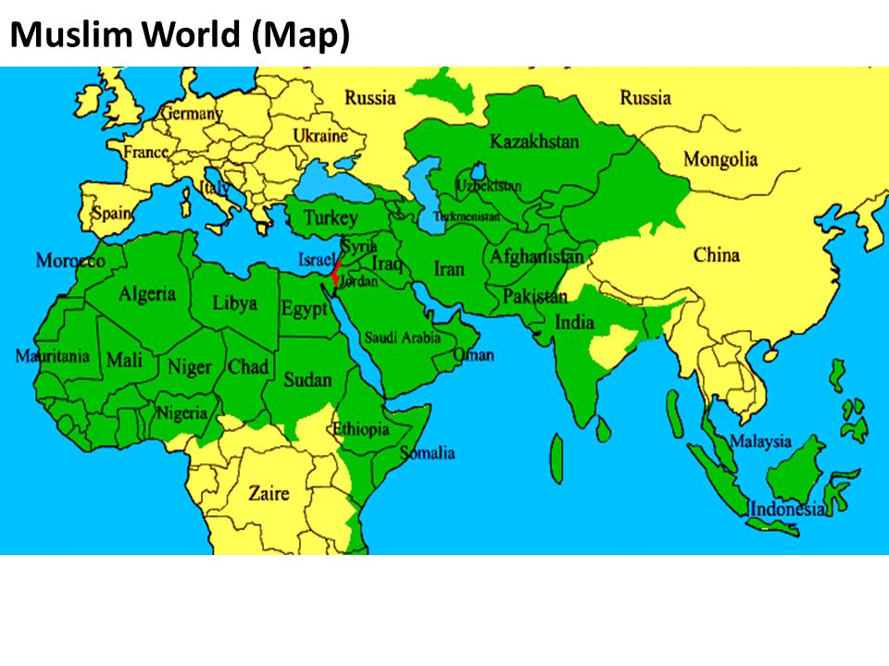
Strategic Significance
Important link in the chain of Muslim countries:

Slide 9
Strategic Significance
Only Muslim country with nuclear capability:
Pakistan is the only Muslim country having nuclear capability which has great influence on the political, socio-economic activities in the region and the maintenance of status quo.

Slide 10
Strategic Significance
CONCLUSION / ANALYSIS: Geo strategic means the importance of a country or a region as by virtue of its geographical location.
While history has been unkind to Pakistan, its geography has been its greatest potential.
Pakistan is a junction of South Asia, west Asia and central Asia; a bridge between resource efficient countries to resource deficient countries.
The world is facing energy crises and terrorism. Pakistan is a route for transportation and a front line state against terrorism.
Moreover Pakistan has been traditionally ally of emerging economic giant; China. So as a result of any significant change in world politics, Pakistan’s geo-strategic significance would further enhance.

